Slide 1
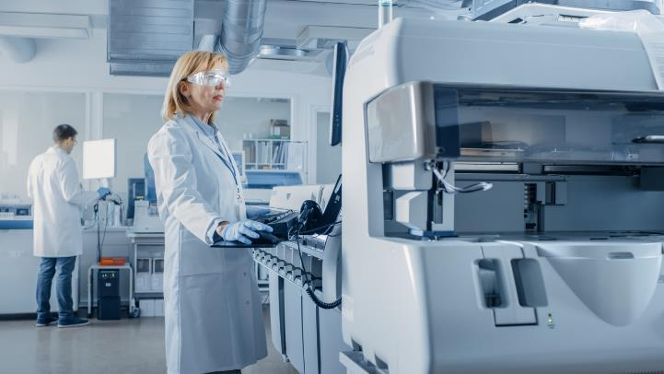
Testing Supply Substitution Strategies
This resource is intended for labs performing COVID-19 tests that are authorized. This resource includes validated supply alternatives that labs can use to continue performing testing when there is a supply issue with some components of a test.
The information in this resource is not intended to alter any already issued EUA for a COVID-19 diagnostic test nor is it intended to speak to any specific FDA regulatory requirement. Rather, the information is being provided to help address availability concerns regarding certain critical components of COVID-19 diagnostic tests during this pandemic.
START: Go to the Main Menu

Slide 2
Real-time RT Polymerase Chain Reaction (PCR) Component Substitution Strategies
Select a button to learn more about a topic
Specimen Collection
Learn about specimen collection, swabs, and media
Intro to PCR
Learn about RT-PCR: what it is and what it’s used for
System Types
Compare use of Open Mix and Match Systems vs. Closed Systems, including
instruments, supplies, and reagents
PCR Testing Process
Learn about the steps in the PCR testing process
Substitution Options
Learn about substitution options for the Open Mix and Match style CDC test
Return to the Main Menu
Additional Resources
Return to FDA FAQ

Slide 3
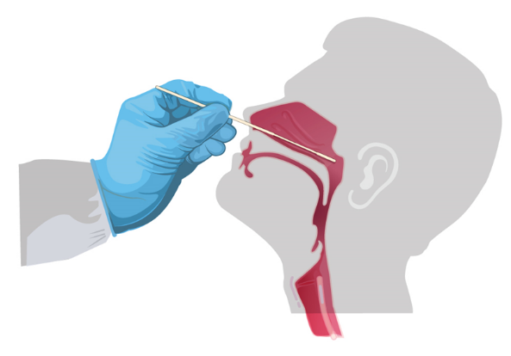
Specimen Collection
Specimen collection is the process of obtaining a sample from a patient, usually by swabbing the nose or mouth, then placing the swab in a tube that is commonly filled with liquid (media) which maintains the sample for transport to the lab.
Originally, specimen collection for SARS-CoV-2 testing required a specialized Nasopharyngeal (NP) swab and Viral Transport Media (VTM)/ Universal Transport Media (UTM).
Options for swabs and media are below.
Explore acceptable choices for swabs
Explore acceptable choices for media
For more information please see the FDA FAQ on this topic under, “What if I Do Not Have…?” It is important that the swab type be appropriate for the anatomic site on which it is used, i.e. only a Nasopharyngeal swab should be used to obtain a Nasopharyngeal specimen.”
Return to the Main Menu
Additional Resources
Return to FDA FAQ

Slide 4
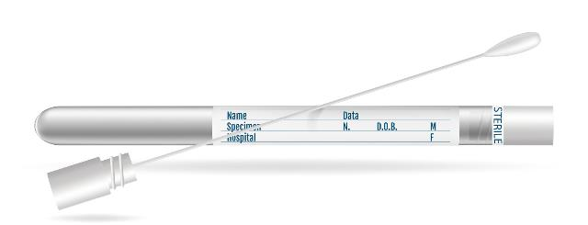
Specimen Collection: Swabs
Choices for Swabs*
NasoPharyngeal (NP) Swab
OroPharyngeal (OP) Swab
Mid-Turbinate (MT) Swab
Flocked, tapered swab
Anterior Nares (“Nasal”) Swab
Round Foam
Spun Polyester
Return to Specimen Collection
* For more information please see the FDA FAQ on this topic under, “What if I Do Not Have…?”
It is important that the swab be appropriate for the anatomic site on which it is used, and that the swab type (e.g. polyester vs rayon) is compatible with that platform. Rayon swabs may not be compatible with all molecular testing platforms. Analytical testing should be performed to confirm compatibility with individual platforms.
Return to PCR Testing Process
“Collect Specimen from Patient”
Return to the Main Menu
Additional Resources
Return to FDA FAQ

Slide 5
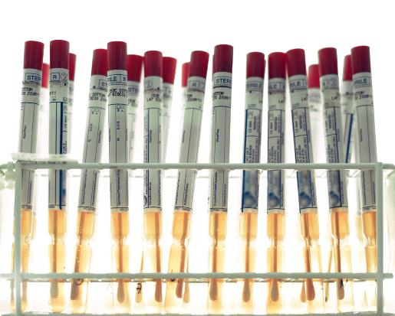
Specimen Collection: Media
Choices for Media
VTM/UTM
Liquid Amies-based Media
e.g., Eswab
Nucleic Acid Transport Media
e.g., Primestore MTM*
Saline Solution
Normal saline
Phosphate-buffered saline (PBS)
Some transport media may contain guanidine thiocyanate, which produces a dangerous chemical reaction releasing cyanide gas when exposed to bleach (sodium hypochlorite). These media may not be compatible with in vitro diagnostic products that do not utilize guanidine thiocyanate during sample processing.
*WARNING: Do not use PrimeStore MTM with the Hologic Panther or Panther Fusion Systems due to a disinfecting step involving bleach that is specific to the platform. When the bleach interacts with the guanidine thiocyanate in the transport media, it produces dangerous cyanide gas.
Return to Specimen Collection
Return to PCR Testing Process
“Collect Specimen from Patient”
Return to the Main Menu
Additional Resources
Return to FDA FAQ

Slide 6
What Is RT PCR?
RT-PCR stands for “Reverse-transcriptase polymerase chain reaction” (commonly referred to as “PCR”)
RT-PCR is a method used to detect RNA nucleic acids (a type of genetic material)
PCR is used to detect the presence of SARS-CoV-2, the virus that causes COVID-19 disease
Finding SARS-CoV-2 genetic material in a specimen indicates that a person has been infected with the virus
Return to the Main Menu
Additional Resources
Return to FDA FAQ

Slide 7
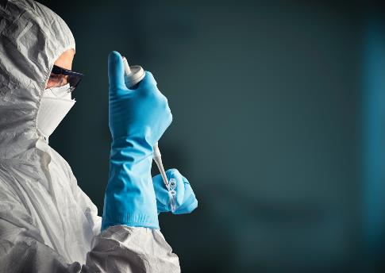
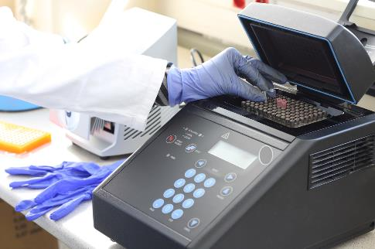
Overview of System Types
Open Mix and Match
Select a system type for more information
Closed System
Extraction
Extraction and Amplification
Amplification
Return to the Main Menu
Additional Resources
Return to FDA FAQ

Slide 8
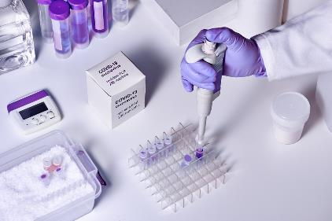
Closed System
Instruments
Supplies and Reagents
A single dedicated instrument performs extraction and amplification
Some materials may be specific to the instrument platform
Proprietary Reagent Kit
Proprietary Reagent Cartridge
Extraction and PCR System
Collection and Media
General Reagents
Return to the Main Menu
Return to Overview of System Types
Additional Resources
Return to FDA FAQ

Slide 9
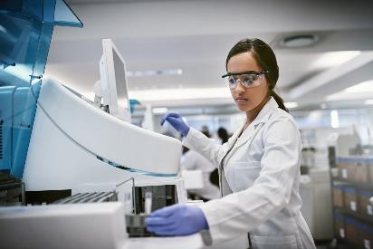
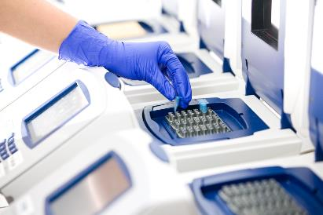
Open Mix and Match (CDC Design)
Instruments
Supplies and Reagents
Extraction and amplification performed separately
Some materials may be usable on more than one system
Extraction System
Primers and Probes
Master Mix
PCR System
Collection and Media
General Reagents
Return to the Main Menu
Return to Overview of System Types
Additional Resources
Return to FDA FAQ

Slide 10
PCR Testing Process
Schematic of SARS-CoV-2 Molecular Diagnostic Assay
STEP 1
Collect Specimen from Patient
STEP 2
RNA Nucleic Acid Extraction
STEP 3
RT-PCR Amplification
STEP 4
Results Reporting
Select the STEPs above for more information about the PCR testing process
Return to the Main Menu
Additional Resources
Return to FDA FAQ

Slide 11
1. Collect Specimen from Patient
2. RNA Nucleic Acid Extraction
3. RT-PCR Amplification
4. Results Reporting
INPUT FOR THIS STEP? A sample from the patient to test for the presence of SARS-CoV-2
WHAT SUPPLIES ARE NEEDED?
A swab to collect the sample.
Transport Media in a collection tube to transport the sample without degradation. The swab carrying the sample is placed in a collection tube filled with transport media.
WHAT IS THE OUTCOME? A sample for PCR analysis
Return to the Main Menu
Return to PCR Test Process Overview
Additional Resources
Return to FDA FAQ

Slide 12
1. Collect Specimen from Patient
2. RNA Nucleic Acid Extraction
3. RT-PCR Amplification
4. Results Reporting
INPUT FOR THIS STEP? A sample for PCR analysis
WHAT SUPPLIES ARE NEEDED?
Extraction System
Extraction Reagents
Lysis Buffer
RNA Extraction Control
Human Specimen Control
Positive Control specific to SARS-CoV-2
WHAT IS THE OUTCOME? Extracted nucleic acids
Return to the Main Menu
Return to PCR Test Process Overview
Additional Resources
Return to FDA FAQ

Slide 13
1. Collect Specimen from Patient
2. RNA Nucleic Acid Extraction
3. RT-PCR Amplification
4. Results Reporting
INPUT FOR THIS STEP? Extracted nucleic acid
WHAT SUPPLIES ARE NEEDED?
PCR REAGENTS
PCR buffer
dNTPs (building blocks of nucleic acids)
Reverse Transcriptase (RT)
No Template Control
Polymerase (Enzyme)
Positive Control (specific to SARS-CoV-2)
Primers and Probe (SARS-CoV-2 specific)
WHAT IS THE OUTCOME? Fluorescence output signal indicating presence of SARS-CoV-2 RNA
Return to the Main Menu
Return to PCR Test Process Overview
Additional Resources
Return to FDA FAQ

Slide 14
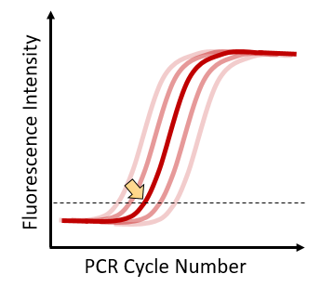
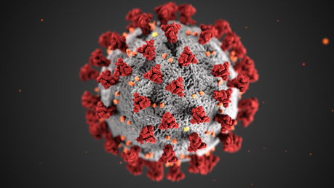
1. Collect Specimen from Patient
2. RNA Nucleic Acid Extraction
3. RT-PCR Amplification
4. Results Reporting
INPUT FOR THIS STEP? Fluorescence output signal
WHAT IS THE OUTCOME? Report of output indicating presence of SARS-CoV-2 virus
Return to the Main Menu
Return to PCR Test Process Overview
Additional Resources
Return to FDA FAQ

Slide 15
Substitution Options*
SELECT A PCR TEST COMPONENT
* Substitution Options are illustrated with the CDC test for this tool. Labs can identify and validate alternative options to other authorized assays.
Primers and Probes
Master Mix
Select a Test Component on the left to explore possible substitutions for the Open Mix and Match style CDC molecular test
PCR System
Controls
Extraction System/Kits
General Consumables
Return to the Main Menu
Additional Resources
Return to FDA FAQ

Slide 16
SELECT A PCR TEST COMPONENT
Primers and Probes are the key reagents for direct detection and identification of a given target sequence.
Primers and Probes
Master Mix
Targets listed in the CDC EUA
PCR System
CDC N1
CDC N2
RNaseP
Controls
CDC Vetted Acceptable Manufacturers (per CDC guidance)
Extraction System/Kits
BioSearch Technologies
Integrated DNA Technologies
General Consumables
Return to the Main Menu
Return to Substitution Options
Additional Resources
Return to FDA FAQ

Slide 17
SELECT A PCR TEST COMPONENT
The master mix contains the reagents for the PCR process. Alternatives will need to be validated with the PCR system.
Primers and Probes
Master Mix
Master mixes listed in the CDC EUA
Quantabio qScript XLT
Quantabio UltraPlex
Promega GoTaq
Thermofisher TaqPath
PCR System
Controls
Validation Needed
Extraction System/Kits
Equivalent Master Mix
General Consumables
Return to the Main Menu
Return to Substitution Options
Additional Resources
Return to FDA FAQ

Slide 18
SELECT A PCR TEST COMPONENT
The PCR system is the instrument performing amplification.
Primers and Probes
Master Mix
PCR system listed in the CDC EUA
Applied Biosystems 7500 Fast Dx Real-Time PCR
PCR System
Controls
Acceptable Alternatives (per FDA FAQ*)
Extraction System/Kits
Applied Biosystems 7500 Fast Real-Time PCR
Applied Biosystems QuantStudio 6 Flex
Applied Biosystems QuantStudio Dx
QIAGEN Rotor-Gene Q MDx
General Consumables
* Check FDA FAQ for updates after 6/3/2020
Return to the Main Menu
Return to Substitution Options
Additional Resources
Return to FDA FAQ

Slide 19
SELECT A PCR TEST COMPONENT
Controls are the reagents that monitor the extraction and amplification process.
Primers and Probes
Master Mix
Controls listed in the CDC EUA
CDC Positive Control
CDC Extraction Control
PCR System
Controls
Acceptable Alternatives (per FDA FAQ*)
Extraction System/Kits
BEI Resources (N1, N2 Positive Control)
Integrated DNA Technologies (N1, N2, Rnase P Positive Control)
Human RNA (Rnase P Positive Control, Extraction Control)
Twist Bioscience (Synthetic RNA Controls)
General Consumables
* Check FDA FAQ for updates after 6/3/2020
Return to the Main Menu
Return to Substitution Options
Additional Resources
Return to FDA FAQ

Slide 20
SELECT A PCR TEST COMPONENT
The Extraction system is the instrument performing extraction. The Extraction kit contains the reagents for the Extraction process.
Primers and Probes
Master Mix
Extraction Systems/kits listed in the CDC EUA
QIAGEN/QIAmp DSP Viral RNA Mini Kit
QIAGEN/QIAamp Viral RNA Mini Kit
QIAGEN EZ1 Advanced XL/EZ1 DSP Virus Kit, Buffer AVL
QIAGEN EZ1 Advanced XL/EZ1 Virus Mini Kit v2.0, Buffer AVL
PCR System
Controls
Acceptable Alternatives (per FDA FAQ*)
QIAGEN QIAcube/QIAmp DSP Viral RNA Mini Kit
QIAGEN QIAcube/ QIAamp Viral RNA Mini Kit
Roche MagNA Pure LC/Total Nucleic Acid Kit
Roche MagNA Pure Compact/Nucleic Acid Isolation Kit I
Roche MagNA Pure 96/DNA and Viral RNA Small Volume Kit
bioMérieux NucliSENS easyMAG/EasyMAG Extraction Reagents, Biohit Pipette Tips
Beckman RNAdvance Viral XP extraction kit
bioMérieux EMAG/EasyMAG Extraction Reagents, EMAG 1000μL Tips
KingFisher Flex/Omega Bio-Tek Mag-Bind Viral DNA/RNA 96 Kit
Applied Biosciences MagMAX Express/Viral/Pathogen Ultra Nucleic Acid Isolation Kit
Promega Maxwell RSC 48/Maxwell RSC Viral Total Nucleic Acid Purification Kit
Extraction System/Kits
General Consumables
* Check FDA FAQ for updates after 6/3/2020
Return to the Main Menu
Return to Substitution Options
Additional Resources
Return to FDA FAQ

Slide 21
SELECT A PCR TEST COMPONENT
General consumable laboratory supplies used in PCR
Primers and Probes
Master Mix
General consumables listed in the CDC EUA
Molecular grade water, nuclease-free
Aerosol barrier pipette tips
Microcentrifuge tubes
DNA Decontamination Reagent (DNAZap)
Surface Decontaminant (RNAse Away)
PCR Reaction Plates
Vortex Mixer
Microcentrifuge
Micropipettes
10% Bleach
MicroAmp Optical 8-cap Strips
PCR System
Controls
Extraction System/Kits
General Consumables
Return to the Main Menu
Return to Substitution Options
Additional Resources
Return to FDA FAQ

Slide 22
Additional Resources
FDA Frequently Asked Questions on Diagnostic Testing for SARS-CoV-2
CDC 2019-Novel Coronavirus (2019-nCoV) Real-Time RT-PCR Diagnostic Panel
Return to the Main Menu
Return to FDA FAQ

